Slide 1

Advanced
Creative
Type of victims
Type of attacks
Attitude
Notes:
Sophisticated attack techniques and exploits, in a creative way
Victims are usually Governments, hospitals, financial institutions
Write their own exploits
Chain together multiple zero-days in a single attack
Don’t hide the attack after done

Slide 2

Persistent
Keep trying
Patient and silently
Distinguish gains
Notes:
Attacker will keep trying until he succeeds
Able to distinguish between short and long term gains; they usually pick the latter to maintain their control and deepen it within the system.

Slide 3
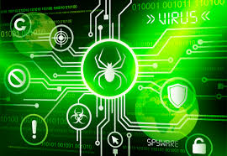
Threats
Motive
Fucosed
Well funded
Notes:
Has a motive
Focused attacks
Orchestrated by a large organization or a well funded group

Slide 4
Characteristics
Purposeful
Risk Tolenrance
Focus on the goal
Resourceful
Multiple Locations
Large Volumes of Traffic
Heavily Funded

Slide 5
How: Kill Chain
Phase 0: Target definition
Phase 1: Intrusion
Phase 2: Further Capture and Persistence
Phase 3: Internal enumeration (Half-stage)
Phase 4: Data Exfiltration
Phase 5: Attack completion

Slide 6

Notorious ATPs
FinFisher/FinSpy
Stuxnet
Operation Red October or Red October
Notes:
Stuxnet: Elaborated government funded and first of its kind attack. To this day still studied as a fine example of the sophistication, well coded and ingenious attack.
Operation Red October or Red October: was a cyberespionage malware program discovered in October 2012 and uncovered in January 2013 by Russian firm Kaspersky Lab. The malware was reportedly operating worldwide for up to five years prior to discovery, transmitting information ranging from diplomatic secrets to personal information, including from mobile devices. The primary vectors used to install the malware were emails containing attached documents that exploited vulnerabilities in Microsoft Word and Excel. Later, a webpage was found that exploited a known vulnerability in the Java browser plugin. Red October was termed an advanced cyberespionage campaign intended to target diplomatic, governmental and scientific research organizations worldwide.
FinFisher can be covertly installed on targets' computers by exploiting security lapses in the update procedures of non-suspect software. Dubious legality, the company that made FinFisher possible has been criticized by human rights organizations for selling these capabilities to repressive or non-democratic states known for monitoring and imprisoning political dissidents.

Slide 7
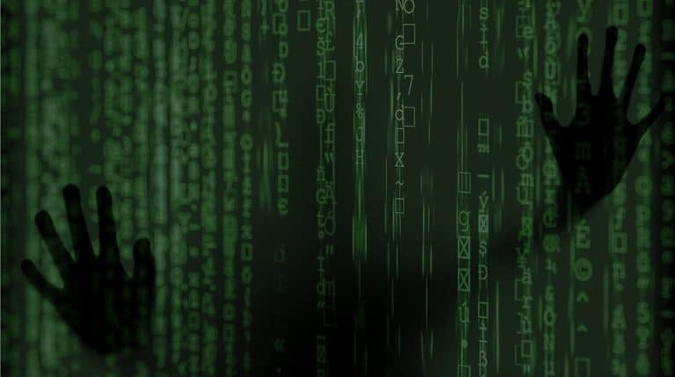
How to Avoid an ATP
Notes:
Regularly patched (Against zero day vulnerabilities)
Well trained employees (Against social engineering attacks)

Slide 8

Conclusão
Notes:
We only know about some of these threats because they were discovered
Sometimes we don’t even know who’s behind these attacks, until the perpetrators acknowledge it. There are still APTs active since their inception. Example: FinSpy. Even though these attacks are massively expensive, anyone can in theory buy and use it, with enough funds and knowledge.
The types of attacks are always evolving and sometimes are very wide in their attacks or specific like Stuxnet
They are a minuscule part of the cyber attacks but they are the most successful and cause the most damage when and if they are found.
The attackers use a variety of vectors to ensure success
The attackers are patient and dedicated. They keep their attacks silent. They know the long term and short term gains of their attacks.
At some point, your organization will be attacked
The bigger the organization, the more valuable it is.

